Slide 1
First Review
MULTISPECTRAL SATELLITE IMAGE DEHAZING
Presented By:
G Sai Avinash
Shaistha M
Naga Kushal Ageeru Nishen Ganegoda
19BTRCR048
19BTRCR014
19BTRCR047
19BTRCR061
Guide :Dr.M.John Basha

Slide 2
Overview
Introduction
What is Mutli-Spectral Image?
Satellite Image Dehazing
Problem Definition
Abstract
Literature Survey
Existing Methods
Proposed System
Methodology
Work Done till now
Software / Hardware requirements
References

Slide 3
Introduction
In recent years there has been a growing interest in using satellite imagery for different tasks in modeling the earth, e.g. creating accurate maps. For this to be possible the satellite images must have a high enough resolution to be able to detect small details.
The usability of the images does not only depend on their resolution but heavily on the quality of their content as well.
Noise particles include:
-Smoke
- Fog
-Mist
-Clouds

Slide 4
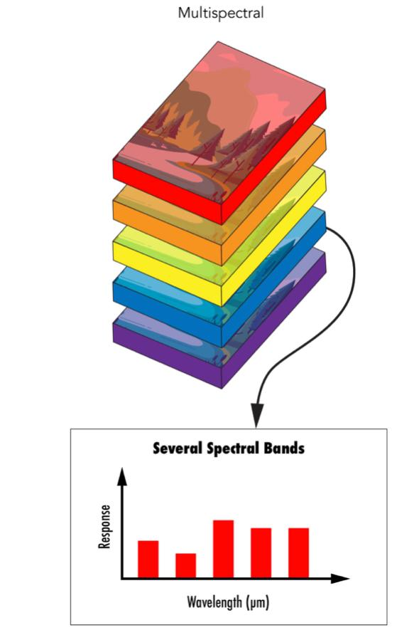
What is Mutli-Spectral Image?
Multispectral imaging is technology used by satellites to capture high intensity images from space.
It is produced by IKONOS satellite sensor
It enables us to anlayse the image deeply by channelizing into various channels.

Slide 5
Satellite Image Dehazing
A multispectral image dehazing tries to improve interpretability in the image regions affected by the presence of haze during acquisition.
In remote sensing, optical multispectral satellite images often suffer from the presence of haze resulting in a lack of contrast and data interpretation.
The process of dehazing tries to recover the information affected due to the presence of haze and therefore servers to increase the data interpretation for manual or automated operations. Haze detection and removal is a challenging and important task for optical multispectral data correction.

Slide 6
Problem Definition / OBJECTIVE
Images captured in hazy or foggy weather conditions make the object features difﬁcult to identify by human vision.
The main objective is to improve the visual quality and read the information behind the hazed image.
General Applications
Remote Sensing
Weather Forecasting
Pollution Estimation

Slide 7

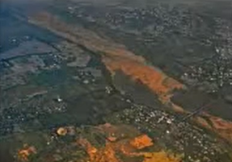

ABSTRACT
The task of image de-hazing has been a challenge in the field of Computer Vision since its inception. The images captured during adverse weather conditions often appear to be of low quality due to the presence of various atmospheric particles, which results in hazed images. We are using statical method called dark channel prior in order to remove haze in the images
Hazed Image
Dehazed Image
Data Set Source: ISRO

Slide 8
State of the Art-work
SL.N O | Author’s Name/ Paper Title | Conference/J ournal Name and year | Technology/ Design | Results shared by author | What you infer
1.) | Yongfei Guo,1Zeshu Zhang,1and Hangfei Yuan1 Single Remote Sensing Multispectral Image Dehazing Based on a Learning Framework | Hindawi journal 2019 | The processing of single hazy image has a significant progress in Some methods based on polarization have been developed in which the development of deep learning, | indicate that compared with the state-of-the art methods, our proposed dehazing method can effectively remove haze in each band of multispectral images under different scenes | The proposed haze synthesis method can generate haze highly close to real conditions, using which to train the dehazing network.
2.) | K. Mounika, N. Harika Reddy, Kalagasahitya, K.V. Alekhya, Karaka Jyoshna, P.Sai Gayathri, K SatyaPriya DEHAZING FOR MULTISPECTRAL REMOTE SENSING IMAGES | International Research Journal of Modernization in Engineering Technology And Science 2019 | The hazy image and its corresponding transmission map is detected effectively based on learning the coefficients of the linear model. | A linear regression model with multiple variables is established and the gradient descent method is applied to the coefficients of the linear model. Then a hazy image accurate transmission map is obtained. | The proposed method can recover a haze-free remote sensing image with good visual effect and high quality.

Slide 9
State of the Art-work
SL.N O | Author’s Name/ Paper Title | Conference/J ournal Name and year | Technology/ Design | Results shared by author | What you infer
3.) | Ravi Raj Choudhary, K K Jisnua, Gaurav Meenaa Image DeHazing Using Deep Learning Techniquesa | International Conference on Computational Intelligence and Data Science (ICCIDS 2019) | Using Computer vision, Convolutionary neural network to create a model to achieve dehazed image | This paper present a deep-learning approach that generates haze free images without any human intervention. | By chnaging the hyper paratmeters in the model we could achive more accuracy and get more clear dehazed image.
4.) | Manjun Qin,Wei Li. Dehazing for Multispectral Remote Sensing Images Based on a Convolutional Neural Network With the Residual Architecture | IEEE Xplore 2018 | Designed Dehazing Framework, Adaptive Fusion, Haze Synthesis Method | The designed network includes two parts. One is the parallel connection of multiple CNN individuals with residual structure. Each individual is used to learn a regression from the hazy image to the clear image. | in this paper, a novel haze removal method based on the deep CNN is proposed for multispectral remote sensing image

Slide 10
Existing Methods
Image Dehazing can be done various methods.
Methods can be classified as:
Neural networks
CNN
Back Projected Pyramid Net (BPP-net)
Statistical Method
Image enhancement
Single image – DCP (dark channel prior)

Slide 11
Proposed system
DARK CHANNEL PRIOR
Effective image prior-dark channel prior to remove haze from a single input image.
The dark channel prior is a kind of statistics of outdoor haze-free images.
Its is based on a key observation – most local patches in outdoor haze-free images contain some pixels whose intensity is very low in at least one color channel.
Hazed Image = Image + Noise

Slide 12
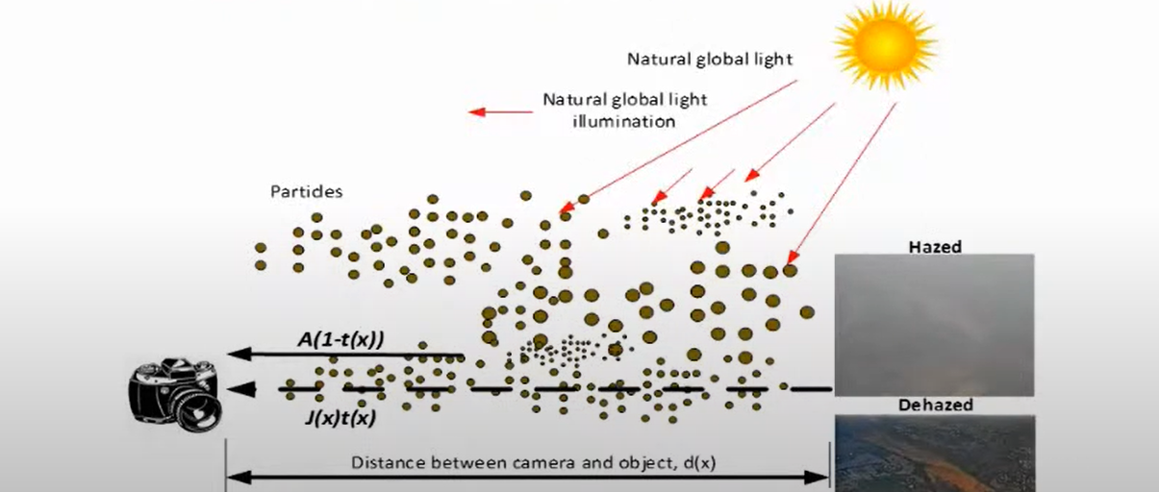
Methodology
DARK CHANNEL PRIOR (DCP)
A widely used haze imaging formation model is present as:
I(x) = J(x)t((x) + A(1 -t(x))
J(x) haze free image, A : atmospheric light,
1(x) : transmission t(x) = e-Bg(x)

Slide 13
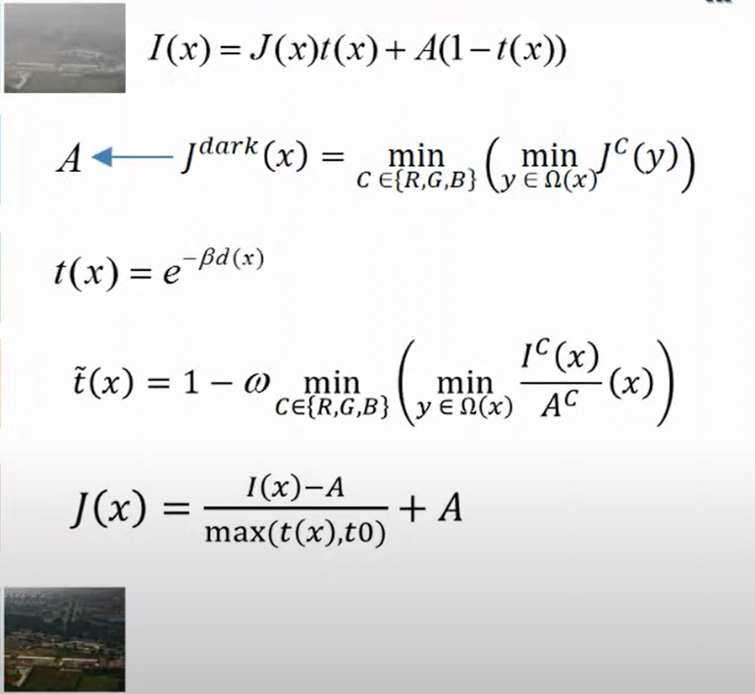
Image Dehazing using Dark Channel Prior
Haze Image
Atmospheric Light estimation
Transmission Map
Refine Transmission Map
Radiance Recovering
Dehaze Image

Slide 14
Work done so for (till first review)-
We are done with selection of method to choose
We are at the stage of implementing and testing the code
Heading towards application in the next review

Slide 15
Software/System Requirements
□System requirements
Operating system : WINDOWS/LINUX/MAC
RAM: 4-8GB
80 GB HDD
GPU:4GB(NVIDIA/AMD)
□Software Requirements
Visual studio
Python version 3 and above version
Java version 8
Python libraries ( Numpy, pandas, sklearn, scipy, keras, TensorFlow).

Slide 16
References
[1.] Liu J, Wang S, Wang X, Ju M, Zhang D. A Review of Remote Sensing Image Dehazing. Sensors (Basel). 2021 Jun 7;21(11):3926. doi: 10.3390/s21113926. PMID: 34200320; PMCID: PMC8201244.
[2.] Z. He, C. Gong, Y. Hu and L. Li, "Remote Sensing Image Dehazing Based on an Attention Convolutional Neural Network," in IEEE Access, vol. 10, pp.
68731-68739, 2022, doi: 10.1109/ACCESS.2022.3185627.
[3.] Hindawi. “Single Remote Sensing Multispectral Image Dehazing Based on a Learning Framework.” Single Remote Sensing Multispectral Image Dehazing Based on a Learning Framework, www.hindawi.com/journals/mpe/2019/4131378. Accessed 22 Sept. 2022.
[4.]www.irjmets.com/uploadedfiles/paper//issue_6_june_2022/26642/final/fin_irj mets1655902241.pdfhttps://www.irjmets.com/uploadedfiles/paper//issue_6_june_ 2022/26642/final/fin_irjmets1655902241.pdf.

Slide 17
ANY QUERIES

Slide 18
THANK YOU

